Slide 1
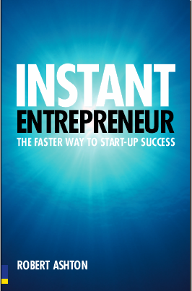

Slide 2
INSTANT ENTREPRENEUR
1. Preparation
Ready, Started, Funded
2. Building the business
Being different, Getting customers, Getting sales, Getting online,
Get networking, Get profitable, Being popular
3. Managing the business
Managing money, Get legal, Get a team, Get a life, Buying better, Surviving a
downturn, Selling your business
People often talk before they can walk -> talk is easier than start from it
“Fake it til you make it”

Slide 3
1. Getting Ready shortcuts to preparing yourself
What makes a successful entrepreneur?
The secrets of objectivity over emotion
Why passion can make almost anything possible
Have you got what it takes? A simple self assessment

Slide 4
2. Getting Started shortcuts to successful business ideas
How to choose and use your business heroes
Shortcut your way to a good plan
Quick and effective market research
Why pioneers often don’t get rich

Slide 5
Google Scholar specifically searches academic work. You can sometimes ‘discover’ inspirational new information here.
Remember as you search that it’s as easy to confuse as to inform yourself. So, before you start researching, work out the following:
How big a market do I need to realise my vision?
If it’s huge, then how will I break it down into segments?
Which of those segments can I do the best with?
Market Research is the Way Out

Slide 6
3. Getting Funded shortcuts to raising cash for your business
Why cash is king in any business
Quick ways to find funds
Potential investors you know, but might overlook
Cash is king
Running out of money is one of the biggest causes of business failure
Solution:
1. Typology:
Business : banking (credit side first) + nonbanking (debt side first)
Financing : Internal (dep., earning, IPO) + External (debt)
2. Time : Short + Long Term

Slide 7
Let’s try to have a self assessment and who and how are we successful then?

Slide 8
Score your answers 1, 2, 3 or 4. Put 1 if you agree totally and 4 if you disagree totally
I am very clear about what I want life to look like in three years’ time. _____
I’ve discussed my life goals with my family and they agree that I’m being realistic. _____
I’ve worked out what I want to have in terms of income and assets. _____
I can see that what I’m doing right now is preparing me for the future I want for myself. _____
I’ve taken some hard knocks over the years and know how to handle stress. _____
I can clearly demonstrate where I have achieved a result where others thought I would fail. _____
Hard work doesn’t frighten me, I know I have the stamina to succeed. _____
My family commitments will allow me the time to do what is needed.
I am convinced that I’m not simply running away from a job I don’t enjoy. _____
I promise I’ll read the rest of this book! _____
Total = 1+2+3...+10
The lower the total, the greater are your chances of success.

Slide 9
Building the Business
Being different (Brand and image)
Getting customers (Marketing success )
Getting sales (Closing deals)
Getting online (Bypass the hype and profit from the internet
Get networking (Spending more time with the right people)
Get profitable (Making more from each sale)
Being popular (Social responsibility)

Slide 10
Managing the business
Managing money (A healthy cash flow)
Get legal (Protect yourself from risk)
Get a team (Recruitment and staff management)
Get a life (Work/life balance = Manage your time, Manage your stress, Get the right balance in your life)
Buying better (Getting the best deals from suppliers)
Surviving a downturn (Coping with recession)
Selling your business (Making it worth lots)

Slide 11
The End

